Slide 1
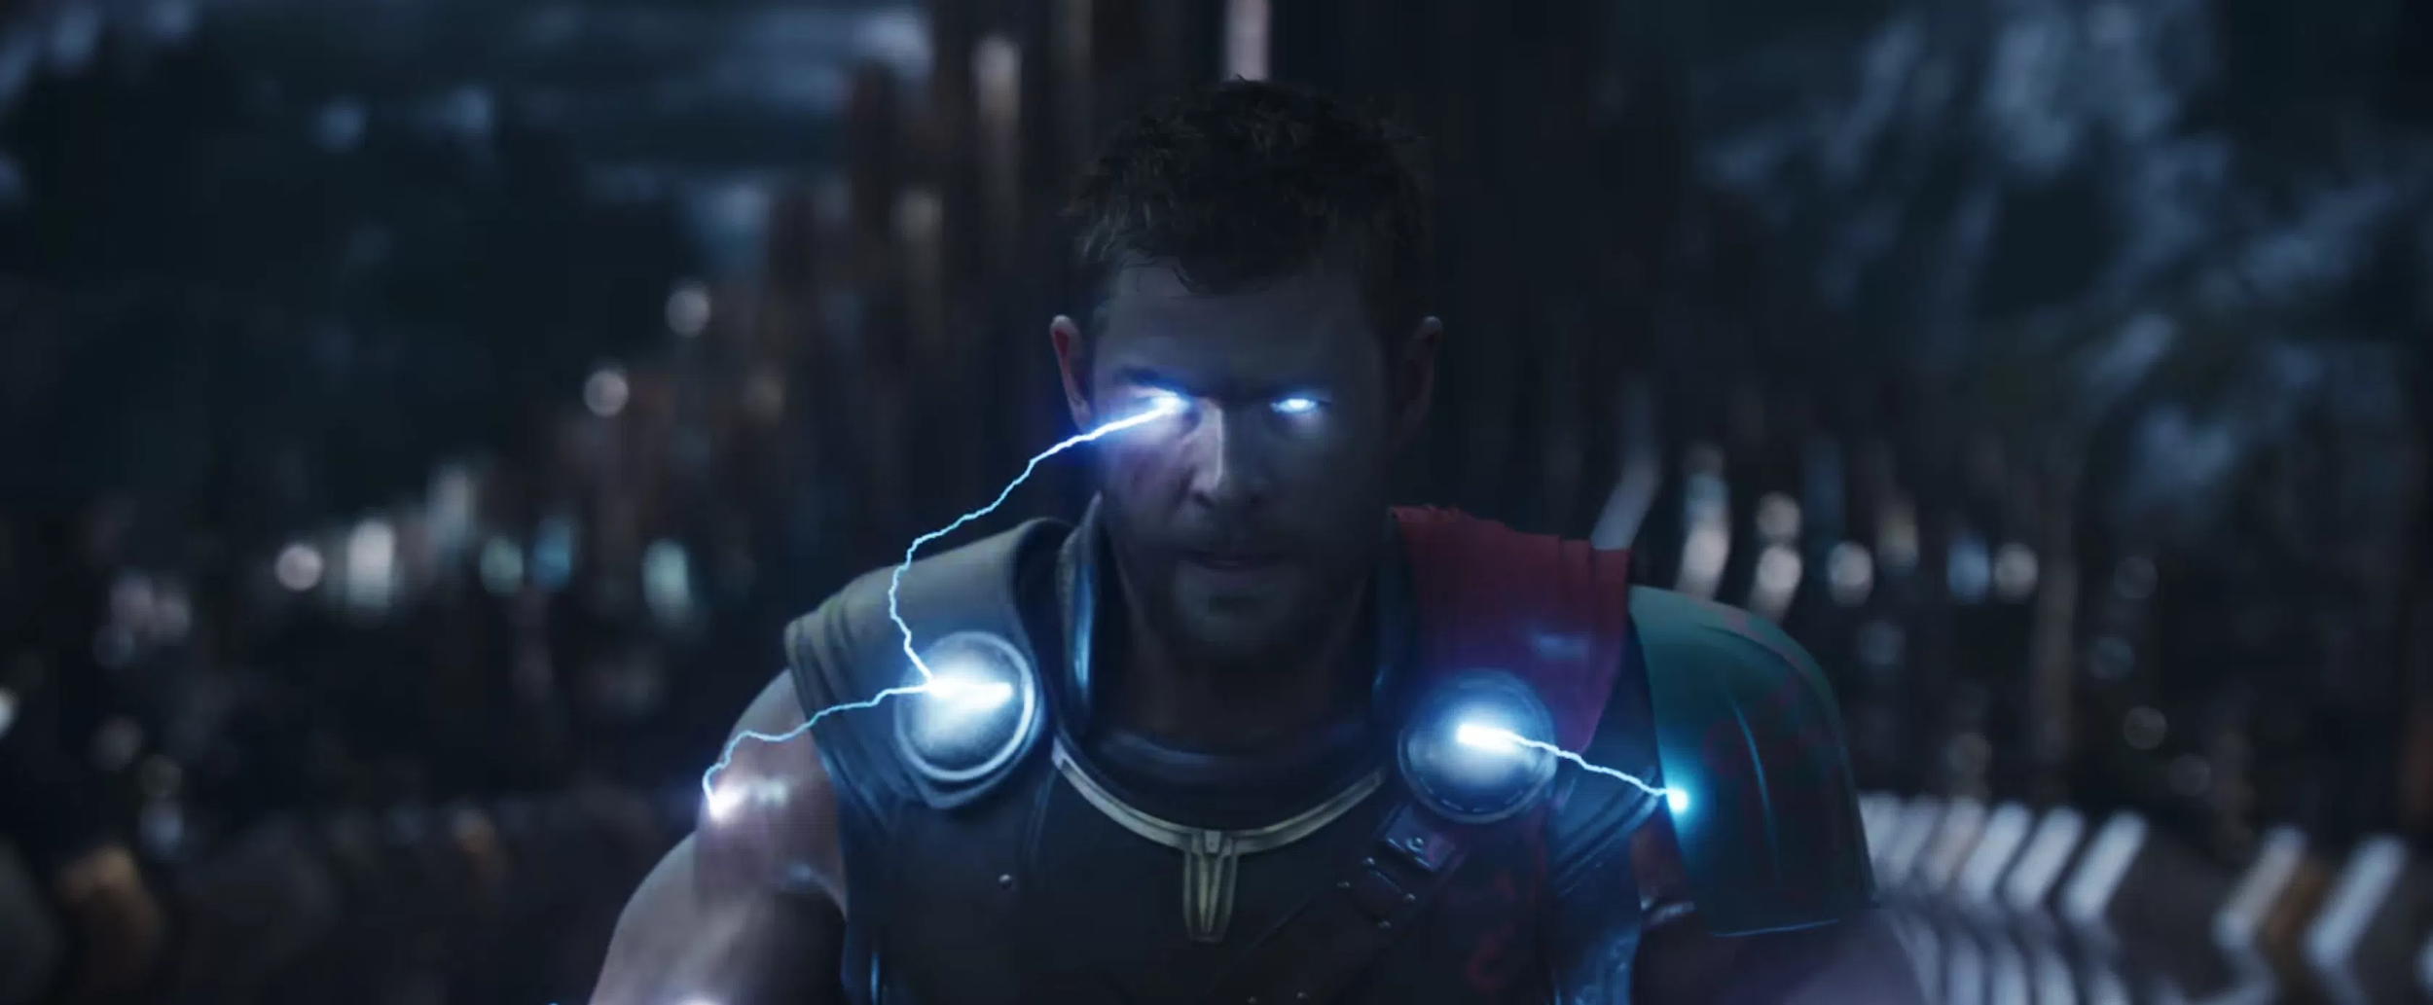
Night Fox：
A Communication Assistant Application for Paralyzed People based on Eye tracking and Sketch Recognition
Final project for CSCE 624 Sketch Recognition
Bing Jiang, Chao Gu, Qiancheng Liu, Aniket Bonde, Paul Taele, Tracy Hammond

Slide 2
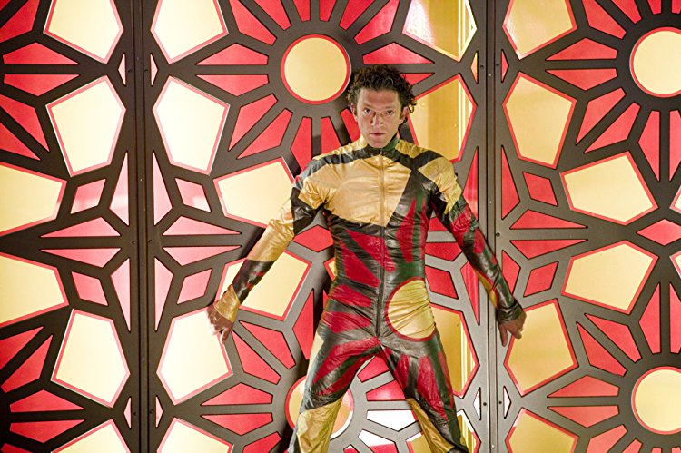
Night Fox：
A Communication Assistant Application for Paralyzed People based on Eye tracking and Sketch Recognition
Final project for CSCE 624 Sketch Recognition
Bing Jiang, Chao Gu, Qiancheng Liu, Aniket Bonde, Paul Taele, Tracy Hammond

Slide 3
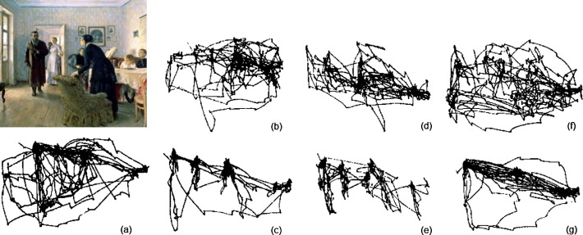
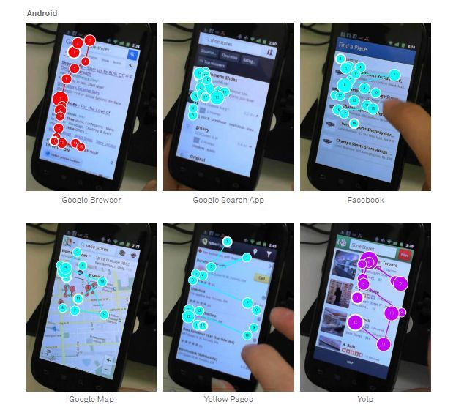
Current Context
Predicting observers’ task from eye movement patterns
Help people with hands disability
Improve life experience.
Apply sketch recognition
Eye tracker
Notes:
Circuit diagrams are an important concept to understand for aspiring computer and electrical engineers, and understanding these diagrammatic concepts can allow such engineering students to progress to more advanced concepts related to circuitry.

Slide 4
Motivation
Tracking eye movement is widely used in Cognitive Research, Medical Service, and many other areas.
Why it’s not good?
It’s expensive and its application is highly limited to several areas.
Why it’s not solved?
The price is high due to the requirement of special camera.
Applications based on eye tracking are not very common
For some simple needs, such as eating, instead of typing in a word “Hamburger” need to gaze for some specific time.

Slide 5

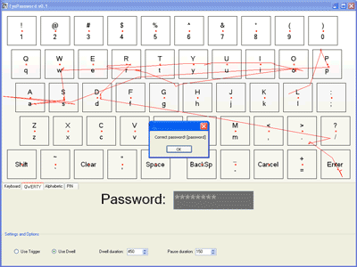
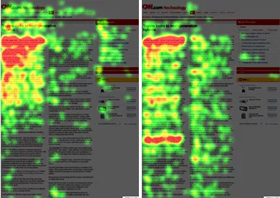
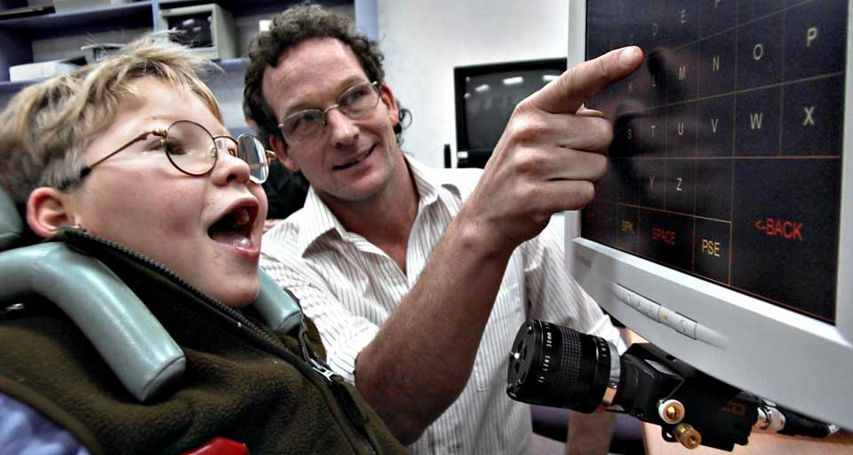
Problem Statement
1. Eye Tracking for typing
3. Assistive technology, Eye tracking for disabled patient
2. Eye Gaze for Software Usability

Slide 6
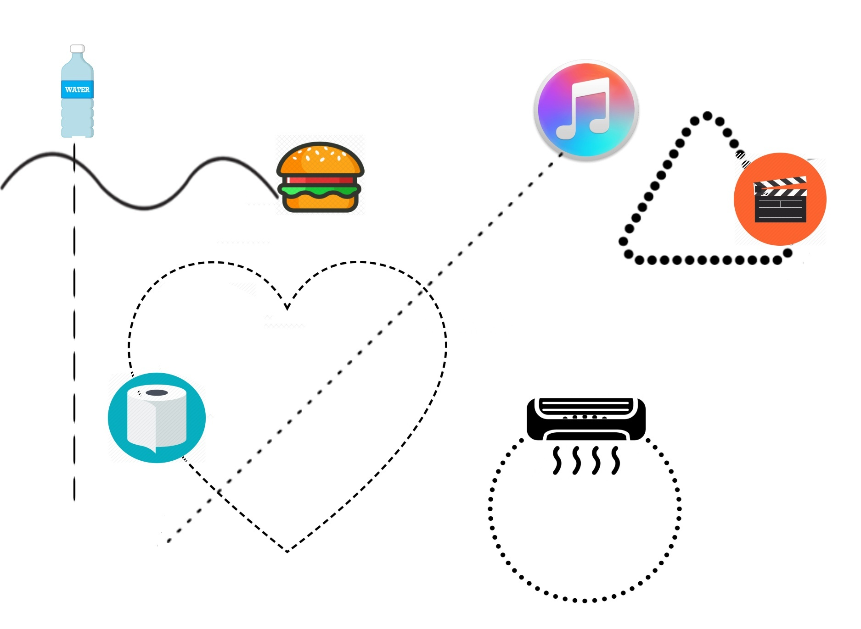
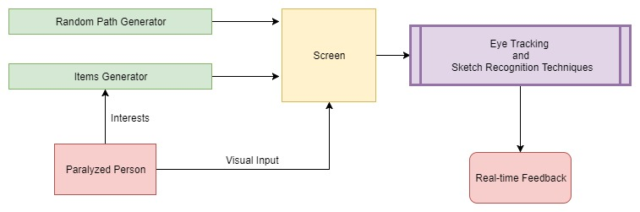
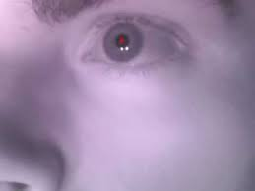
Proposed Solution
Eye tracking coupled with Sketch Recognition to determine interests of paralyzed people
Design a hands-free software as a service application to facilitate ease of use for disabled people.
Notes:
Explanation for point 1: Give example of ‘the facebook’ and ‘food/movies/etc path following’ examples we discussed.
Explanation for point 2: We will create a SAAS application, which can be used by disabled people easily.

Slide 7
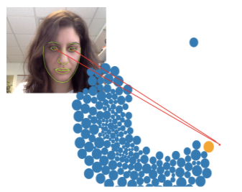
Solution Details
WebGazer.js
Democratizing Webcam Eye Tracking on the Browser
Gather preliminarily eye movement with regular webcam
Generate usable eye-sketching data based on eye movement
Implement an web-based interface using HTML, CSS and Javascript
Applying sketch recognition methods to match the eye movement path with items’ movement path
Rubine’s features
Resample and Template matching
The system give user feedback or respond based on the result.

Slide 8
Planned Evaluation
We can test our recognition accuracy and the system performance in two steps:
Recognition accuracy:
whether the system can recognize user’s eye movement correctly
F-measure, accuracy
System performance:
Whether it can and give the correct feedback or response in time.
Running time for recognition
Notes:
We can test our recognition accuracy and the system performance in two steps:
The first one is Recognition accuracy: it is to test whether the system can recognize user’s eye movement correctly and t to test whether the system can recognize the correct object that user want. We use F-measurement to indicates the accuracy.
The second one is System performance: it is to test whether the system can give the correct feedback or response in time.

Slide 9
Claimed Contributions
The contributions of our system is enabling paralyzed people to select items on the screen more effectively by tracking them with their eyes in a more intuitive way.
The contributions of our work is to expand the accessibility of more robust communication computing resources to people with paralysis.

